Slide 1
CS209: Computer Science II

Slide 2
Unit 3 Module 4:
Exceptions
Introducing Exceptions
Exceptions Flow of Control
Try/Catch
Multiple Throws
Nested Try Blocks

Slide 3
Exceptions
Indicate that something unexpected has occurred or been detected
Allow program to deal with the problem in a controlled manner
Can be as simple or complex as program design requires

Slide 4
Exceptions - Terminology
Exception: object or value that signals an error
Throw an exception: send a signal that an error has occurred
Catch/Handle an exception: process the exception; interpret the signal

Slide 5
Exceptions – Key Words
throw – followed by an argument, is used to throw an exception
try – followed by a block { }, is used to invoke code that throws an exception
catch – followed by a block { }, is used to detect and process exceptions thrown in preceding try block. Takes a parameter that matches the type thrown.

Slide 6
Exceptions – Flow of Control
A function that throws an exception is called from within a try block
If the function throws an exception, the function terminates and the try block is immediately exited. A catch block to process the exception is searched for in the source code immediately following the try block.
If a catch block is found that matches the exception thrown, it is executed. If no catch block that matches the exception is found, the program terminates.

Slide 7
Exceptions – Example (1)
// function that throws an exception
int totalDays(int days, int weeks)
{
if ((days < 0) || (days > 7))
throw "invalid number of days";
// the argument to throw is the
// character string
else
return (7 * weeks + days);
}

Slide 8
Exceptions – Example (2)
try // block that calls function
{
totDays = totalDays(days, weeks);
cout << "Total days: " << days;
}
catch (char *msg) // interpret // exception
{
cout << "Error: " << msg;
}

Slide 9
Exceptions – What Happens
try block is entered. totalDays function is called
If 1st parameter is between 0 and 7, total number of days is returned and catch block is skipped over (no exception thrown)
If exception is thrown, function and try block are exited, catch blocks are scanned for 1st one that matches the data type of the thrown exception. catch block executes

Slide 10
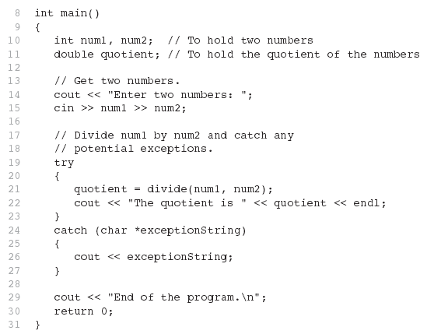
From Program 16-1

Slide 11
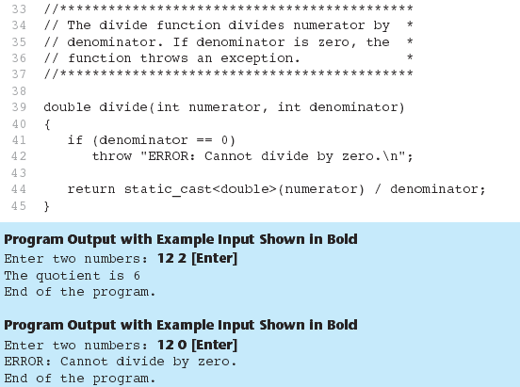
From Program 16-1

Slide 12
From Program 16-1

Slide 13
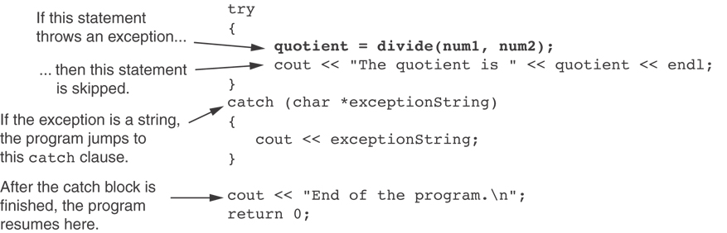
What Happens in theTry/Catch Construct

Slide 14
Clarity…
try
{
cout << "Enter number of donuts:\n";
cin >> donuts;
cout << "Enter number of glasses of milk:\n";
cin >> milk;
if (milk <= 0)
throw donuts;
dpg = donuts / static_cast<double>(milk);
cout << donuts << " donuts.\n"
<< milk << " glasses of milk.\n"
<< "You have " << dpg
<< " donuts for each glass of milk.\n";
}
catch ( int e)
{
cout << e << " donuts, and No Milk!\n"
<< "Go buy some milk.\n";
}

Slide 15
Using a function…
Main()
try
{
quotient = safeDivide(numerator, denominator);
}
catch(DivideByZero)
{
cout << "Error: Division by zero!\n"
<< "Program aborting.\n";
exit(90);
}
safeDivide
double safeDivide( int top, int bottom) throw (DivideByZero)
{
if (bottom == 0)
throw DivideByZero( );
return top / static_cast<double>(bottom);
}

Slide 16
Using a function…
Main()
try
{
quotient = safeDivide(numerator, denominator);
}
catch(DivideByZero)
{
cout << "Error: Division by zero!\n"
<< "Program aborting.\n";
exit(90);
}
safeDivide
double safeDivide( int top, int bottom) throw (DivideByZero)
{
if (bottom == 0)
throw DivideByZero( );
return top / static_cast<double>(bottom);
}

Slide 17
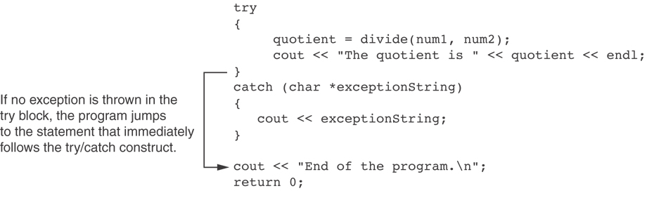
What if no exception is thrown?

Slide 18
Review – try/catch/throw
try-throw-catch
The basic mechanism for throwing and catching exceptions is a try-throw-catch
sequence. The throw statement throws the exception (a value). The catch block catches the exception (the value). When an exception is thrown, the try block ends and then the code in the catch block is executed. After the catch block is completed, the code after the catch block or blocks is executed (provided the catch block has not ended the program or performed some other special action).
(The type of the thrown exception must match the type listed for the catch-block
parameter or else the exception will not be caught by that catch block. This is “Multiple Throws and Catches.” )
If no exception is thrown in the try block, then after the try block is completed, program execution continues with the code after the catch block or blocks. (In other words, if no exception is thrown, the catch block or blocks are ignored.)

Slide 19
Exceptions - Notes
Predefined functions such as new may throw exceptions
The value that is thrown does not need to be used in catch block.
in this case, no name is needed in catch parameter definition
catch block parameter definition does need the type of exception being caught

Slide 20
Exceptions - Notes
#include <iostream>
#include <exception>
using namespace std;
int main () {
try
{
int* myarray= new int[1000];
}
catch (exception& e)
{
cout << "Standard exception: " << e.what() << endl;
}
return 0;
}
capturing by reference
virtual member function

Slide 21
Exception Not Caught?
An exception will not be caught if
it is thrown from outside of a try block
there is no catch block that matches the data type of the thrown exception
If an exception is not caught, the program will terminate

Slide 22
Exceptions and Objects
An exception class can be defined in a class and thrown as an exception by a member function
An exception class may have:
no members: used only to signal an error
members: pass error data to catch block
A class can have more than one exception class

Slide 23
Exceptions - Notes
STL and the exception class
#include <exception>
throw std::exception(“bad error today…”)
when we catch, use objectName.what()
#include <new>
using std::bad_alloc
catch (std::bad_alloc& badStuff)
badStuff.what()

Slide 24
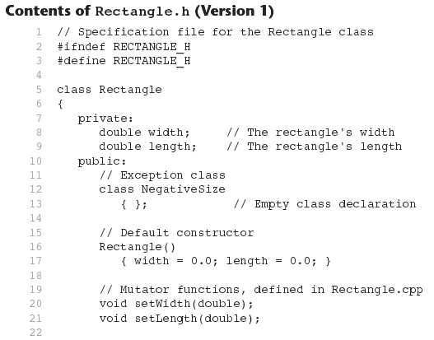

Slide 25
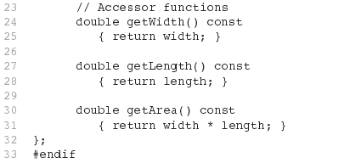
Contents of Rectangle.h (Version1) (Continued)

Slide 26
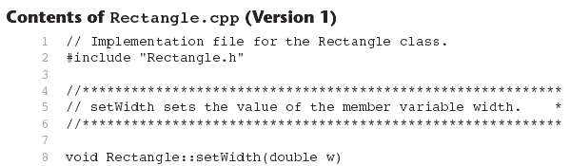
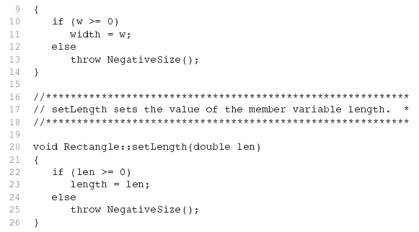

Slide 27
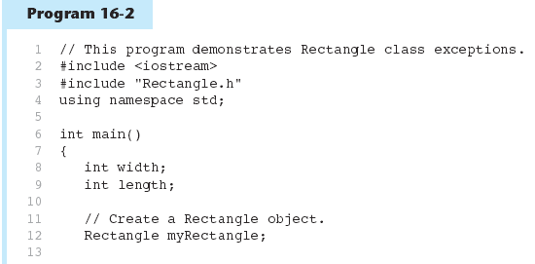

Slide 28
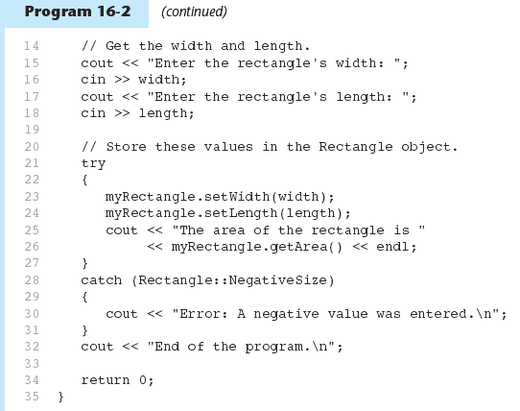

Slide 29
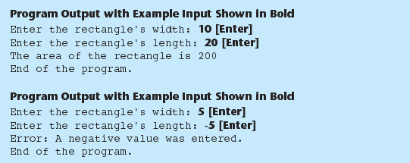
Program 16-2 (Continued)

Slide 30
Multiple Throws and Catches
// Exception class for a negative width
class NegativeWidth
{ };
// Exception class for a negative length
class NegativeLength
{ };
try
{
myRectangle.setWidth(width);
myRectangle.setLength(length);
cout << "The area of the rectangle is "
<< myRectangle.getArea() << endl;
}
catch (Rectangle::NegativeWidth)
{
cout << "Error: A negative value was given "
<< "for the rectangle's width.\n";
}
catch (Rectangle::NegativeLength)
{
cout << "Error: A negative value was given "
<< "for the rectangle's length.\n";
Specification file
Program coding

Slide 31
Multiple Throws and Catches
// Exception class for a negative width
class NegativeWidth
{ };
// Exception class for a negative length
class NegativeLength
{ };
try
{
myRectangle.setWidth(width);
myRectangle.setLength(length);
cout << "The area of the rectangle is "
<< myRectangle.getArea() << endl;
}
catch (Rectangle::NegativeWidth)
{
cout << "Error: A negative value was given "
<< "for the rectangle's width.\n";
}
catch (Rectangle::NegativeLength)
{
cout << "Error: A negative value was given "
<< "for the rectangle's length.\n";
Specification file
BTW our exception classes have no member variables and no member functions - it is a trivial exception. It has nothing but its name, but that is useful enough.
It can activate the appropriate catch block
Program coding

Slide 32
Multiple Throws and Catches
public:
// Exception class for a negative width
class NegativeWidth
{
private:
int value;
public:
NegativeWidth(int val)
{ value = val; }
int getValue() const
{ return value; }
};
try
{
myRectangle.setWidth(width);
myRectangle.setLength(length);
cout << "The area of the rectangle is "
<< myRectangle.getArea() << endl;
}
catch (Rectangle::NegativeWidth e)
{
cout << "Error: " << e.getValue()
<< " is an invalid value for the"
<< " rectangle's width.\n";
}
Specification file
Program coding

Slide 33
What Happens After catch Block?
Once an exception is thrown, the program cannot return to throw point. The function executing throw terminates (does not return), other calling functions in try block terminate, resulting in unwinding the stack
If objects were created in the try block and an exception is thrown, they are destroyed.

Slide 34
Nested try Blocks
try/catch blocks can occur within an enclosing try block
Exceptions caught at an inner level can be passed up to a catch block at an outer level:
catch ( )
{
...
throw; // pass exception up
} // to next level

Slide 35
Review – try/catch/throw
catch -Block Parameter
The catch-block parameter is an identifier in the heading of a catch block that serves
as a placeholder for an exception (a value) that might be thrown. When a suitable value is thrown in the preceding try block, that value is plugged in for the catch-block parameter.
(In order for the catch block to be executed, the value thrown must be of the type given
for its catch-block parameter.) You can use any legal (nonreserved word) identifier for a
catch-block parameter.
EXAMPLE
catch(int e)
throw Statement SYNTAX
throw Expression_for_Value_to_Be_Thrown;
When the throw statement is executed, the execution of the enclosing try block is
stopped. If the try block is followed by a suitable catch block, then flow of control is
transferred to the catch block. A throw statement is almost always embedded in a
branching statement, such as an if statement. The value thrown can be of any type.
EXAMPLE
if (someVariable <= 0)
throw MyIntegerVariable;

Slide 36
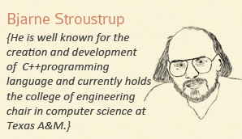
I take exception to all this.

Slide 37
References
Slide contributions include:
Walter Savitch, Problem solving with C++ (9th Edition). Addison-Wesley Longman Publishing Co., Inc. Boston, MA, USA ©2015
Gaddis, Starting Out with C++: From Control Structures through Objects, (8th Ed.) , Addison-Wesley Longman Publishing Co., Inc. Boston, MA, USA ©2015
Bjarne Stroustrup, The C++ Programming Language, 3rd Edition, Addison-Wesley Longman Publishing Co., Inc. Boston, MA, USA ©2007
Herb Sutter, Andrei Alexandrescu, C++ coding standards : 101 rules, guidelines, and best practices, Copyright © 2005 Pearson Education, Inc.
Paul Deitel & Harvey Deitel, C++ How to Program, (7th Ed.) © 2010 by Pearson Education, Inc.
Upper Saddle River, New Jersey 07458
Scott Meyers, Effective Modern C++. Copyright © 2015 (O’Reilly) , 978-1-491-90399-5.
Andrew Koenig and Barbara E. Moo, Accelerated C++ Practical Programming by Example,
Addison-Wesley, 2000 ISBN 0-201-70353-X

Slide 38
References
Slide contributions include:
Frank M. Carrano. Data Abstraction & Problem Solving with C++ (5th Edition)
Addison-Wesley Longman Publishing Co., Inc. Boston, MA, USA ©2006
TutorialsPoint - http://www.tutorialspoint.com/cplusplus/
Cplusplus.com - http://www.cplusplus.com/doc/tutorial/
http://www.keithschwarz.com/cs106l/fall2010/course-reader/Ch5_STLSequenceContainers.pdf

